Slide 1
An investigation into countries significant factors to mortality
2010-2017
CAS M2 Final Project
Filipe Maximiano & Laura Cunha Silva
19.10.2022

Slide 2
Datasets used & contextualization
Source: Kaggle (https://www.kaggle.com/datasets/varpit94/worldwide-deaths-by-risk-factors?resource=download)
This dataset shows the total annual deaths due to each risk factor, by country. The data is downloaded from WHO website.
Each record provides details for a particular country/year. Total annual deaths are provided for each risk factor, with the column name of risk factor.
1
Source: Gap minder (https://www.gapminder.org/data/)
Datasets on worldwide life expectancy, gini coefficient, freedom index and average daily income per capita. Data provided for each country and collected/predicted from 1800-2050.
2
3
Source: The World Bank (https://data.worldbank.org/indicator/SP.POP.TOTL)
Dataset on worldwide total population numbers from 1950 to 2020.

Slide 3
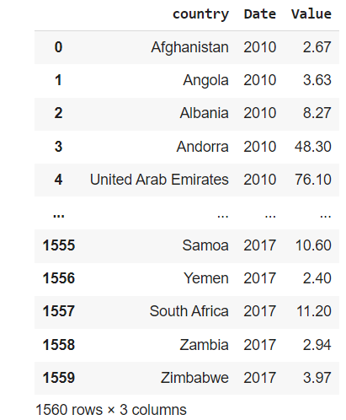
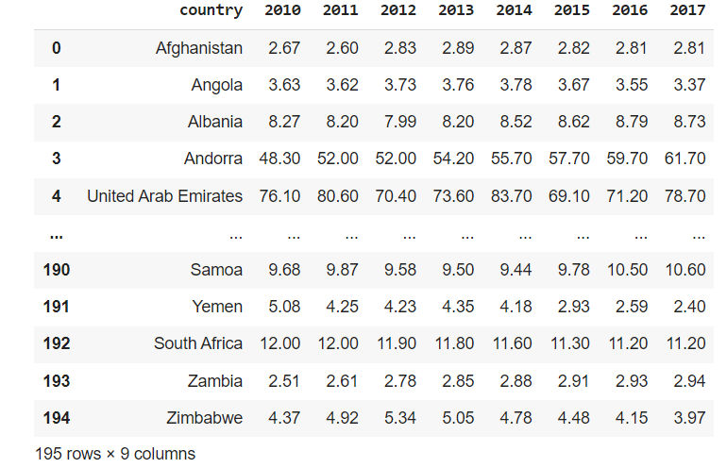
Data Cleaning & Preparation - pt. 1
Subset data to include only our time period of interest = 2010-2017
Transpose datasets for posterior smooth merging

Slide 4
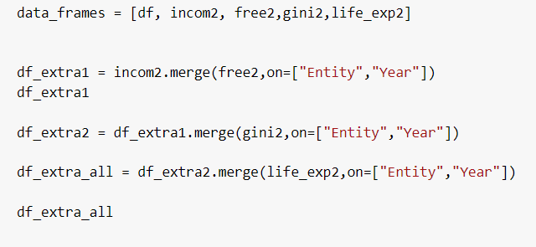
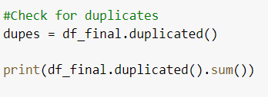
Data Cleaning & Preparation - pt.2
Merge all datasets of interest
Check for the presence of duplicates
Before merging all datasets Taiwan and Eritrea were removed. Taiwan was not present in the total population dataset and Eritrea had no data

Slide 5
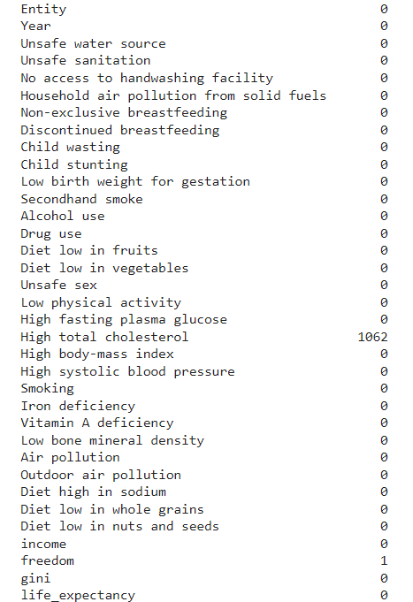
Data Cleaning & Preparation - pt.3
Remove NA’s and substitute them by the average value of the risk factor, grouped by country
South Sudan only became independent in 2011, therefore no data was available in 2010. We decided to attribute 2011’s freedom index value to 2010

Slide 6
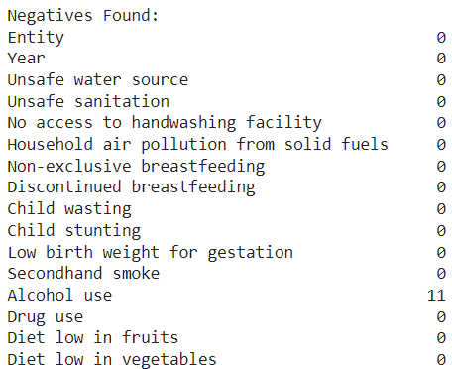
Data Cleaning & Preparation - pt.4
Check for negative values and in Malta substitute all values for 0 (all negative values) & in Macedonia replace with the average (only 3 years)

Slide 7
Dataset description
1400 observations
36 variables = 'Entity','Year', 'Unsafe water source', 'Unsafe sanitation','No access to handwashing facility','Household air pollution from solid fuels','Non-exclusive breastfeeding', 'Discontinued breastfeeding','Child wasting', 'Child stunting', 'Low birth weight for gestation','Secondhand smoke', 'Alcohol use', 'Drug use', 'Diet low in fruits','Diet low in vegetables', 'Unsafe sex', 'Low physical activity','High fasting plasma glucose', 'High total cholesterol','High body-mass index', 'High systolic blood pressure', 'Smoking','Iron deficiency', 'Vitamin A deficiency', 'Low bone mineral density','Air pollution', 'Outdoor air pollution', 'Diet high in sodium','Diet low in whole grains', 'Diet low in nuts and seeds', 'income','freedom', 'gini', 'life_expectancy' ,’Total population’
1
2
3
Notes:
WHY DO WE HAVE DECIMAL VALUES?
these are total annual number of deaths due to a risk factor. The values are fractions because WHO has estimated them for the whole country based on the relatively smaller records found in each country. Hope this answers your question.

Slide 8
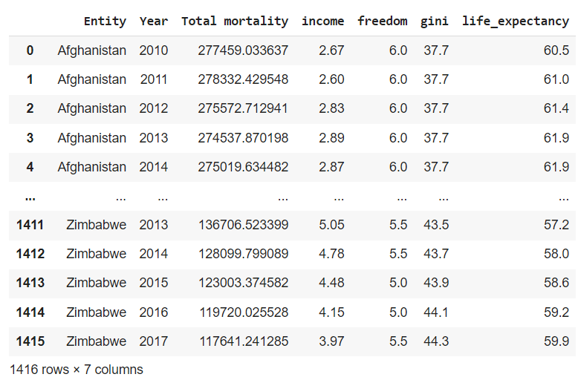
Create our analysis dataset
Calculate the total mortality for each country

Slide 9

Mortality rate = total mortality/total population*100000
Our measure of a countries’ mortality

Slide 10
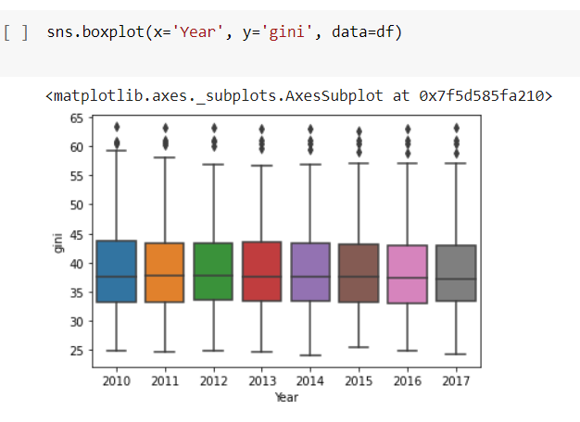
Data visualization
How has the world’s gini coefficient changed over the years (2010-2017)?
The gini coefficient = measurement of income inequality
The gini coefficient has over the years slightly reduced, with the biggest reduction being noticable between 2011 and 2012 (upper whisker reduction + smaller maximum value)

Slide 11
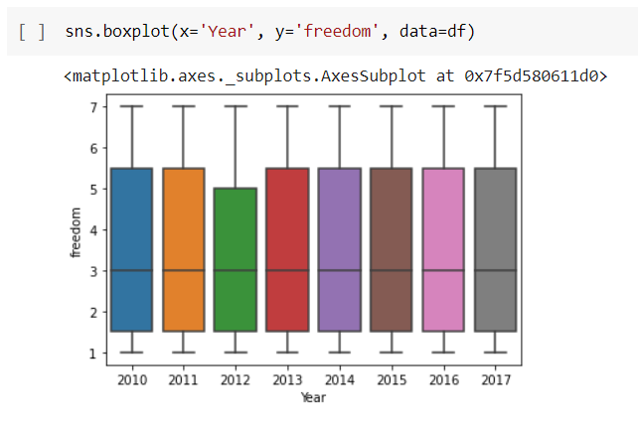
How has the world’s overall freedom index changed over the years (2010-2017)?
Freedom index = broad measure of human freedom. The higher the value the worse
The overall freedom index has remained stable over the years (same median) although in 2012 a reduction in the 75th percentile is noticeable

Slide 12
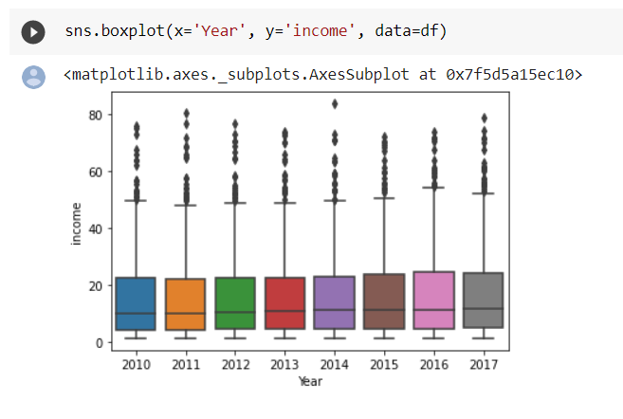
How has the world’s income changed over the years (2010-2017)?
Average daily household per capita income
Although the median has remained stable over the years it is clear that there is a clear discrepancy between the majority of average daily household income and the bigger income spending households (outliers)

Slide 13
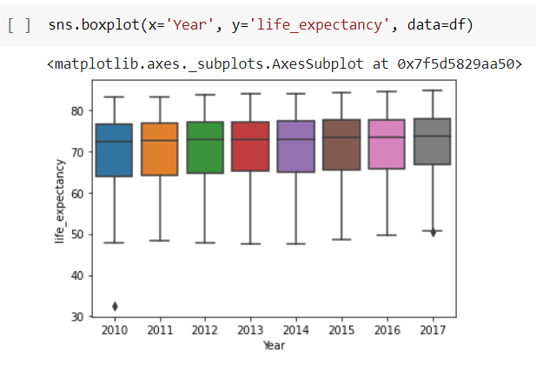
How has life expectancy changed over the years (2010-2017)?
Life expectancy = average number of years a newborn child would live if current mortality pattern remain unchanged
Life expectancy has been increasing steadily over the years.
Outliers present in 2010 and 2017 with a big discrepancy present in 2010.

Slide 14
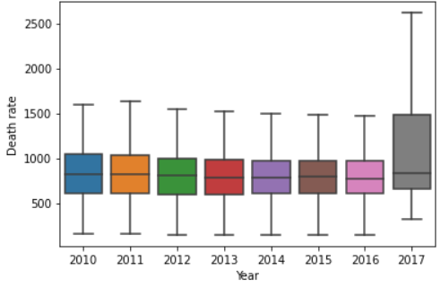
Data visualization
Death rate per 100000 inhabitants over the years
An obvious outlier was present in 2017 - Iceland’s death rate was > 100000
The row containing such information was eliminated

Slide 15


Select a year for analysis
Our analysis was focused on 2017; Therefore the dataset was filtered for 2017

Slide 16
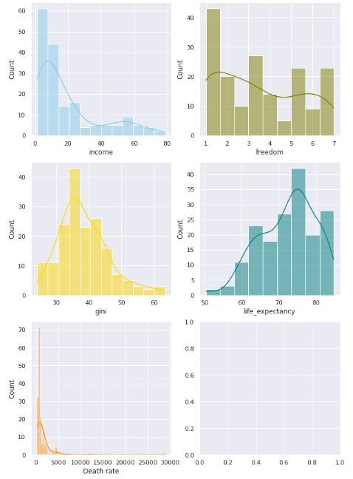

Test normality

Slide 17
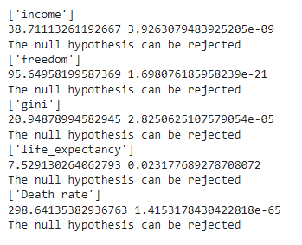
Test normality
All variables of interest were tested using the D’Agostino K-square test
H0= The sample comes from a normal distribution.
H1=The sample is not normally distributed.

Slide 18
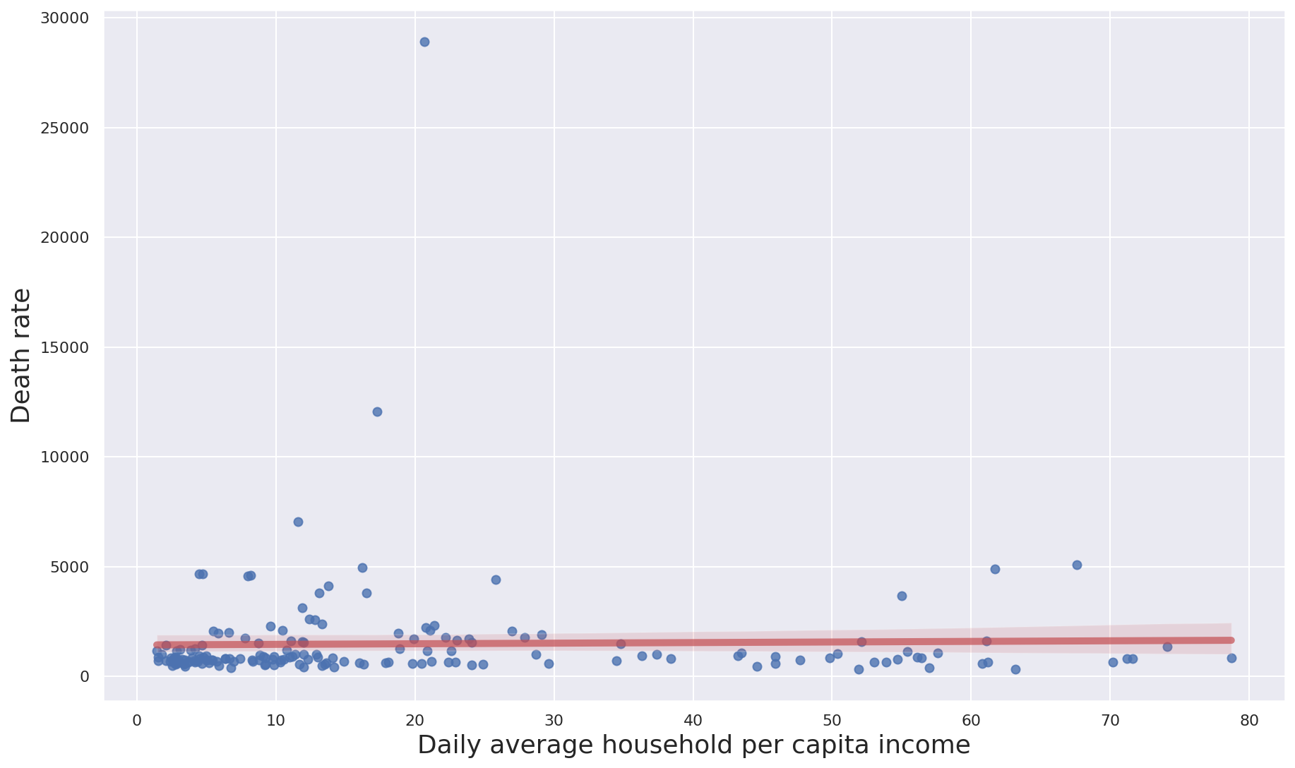
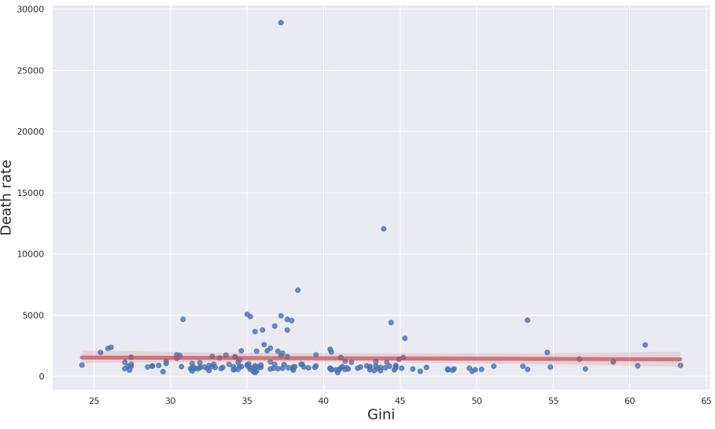
Scatterplots - pt.1

Slide 19
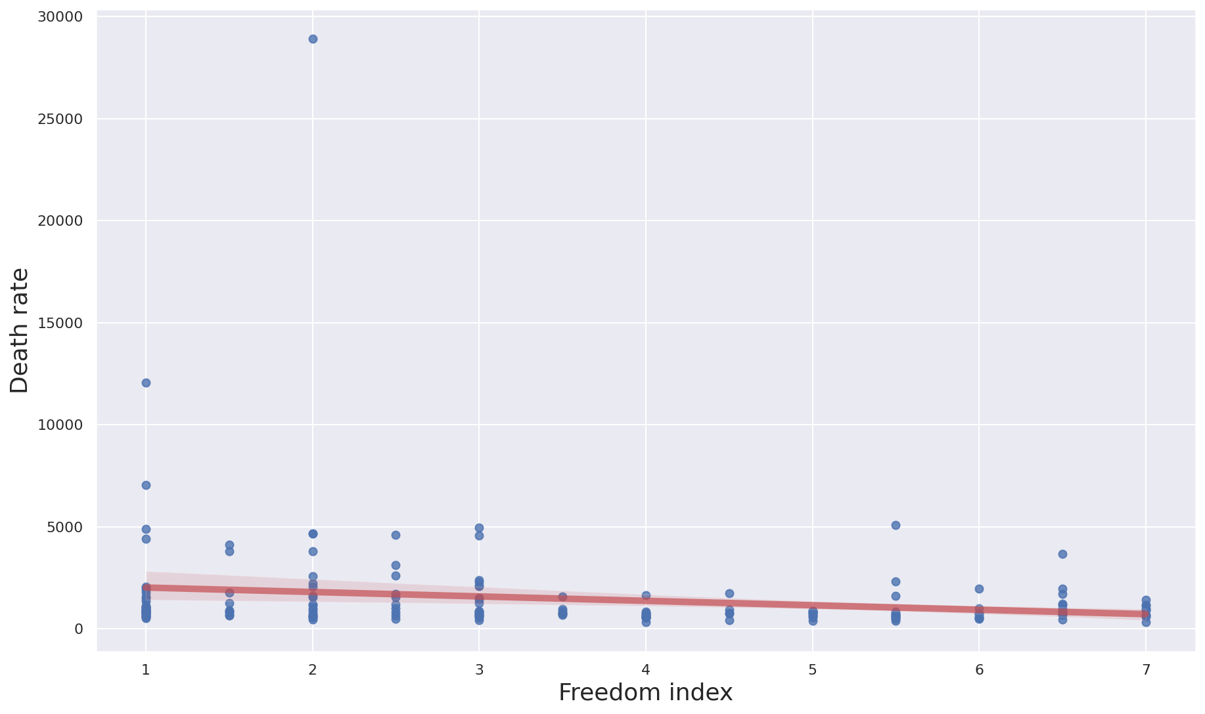
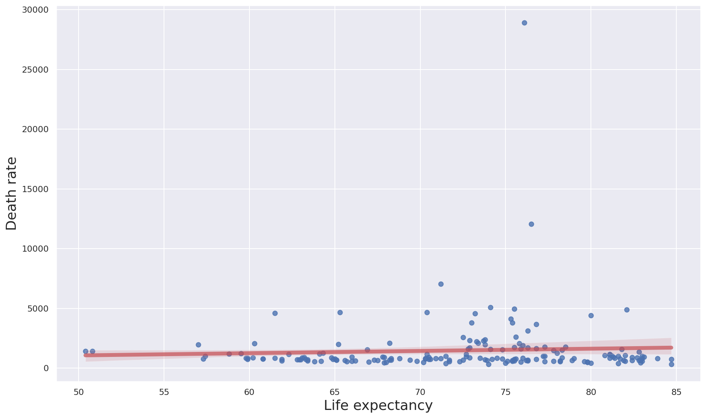
Scatterplots - pt.2
Least free countries seem to have smaller death rates.
Possible explanation = Because we applied Spearman’s this outlier might have a big impact on the results

Slide 20
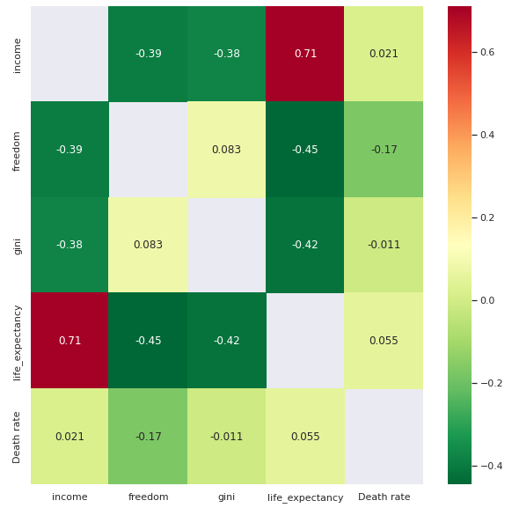
Correlogram
As the average daily household per capita income (income) increases, life expectancy increases
Notes:
The correlogram represents the correlations for all pairs of variables. Positive correlations are displayed in red and negative correlations in green. The intensity of the color is proportional to the correlation coefficient so the stronger the correlation (i.e., the closer to -1 or 1), the darker the boxes. The color legend on the right hand side of the correlogram shows the correlation coefficients and the corresponding colors.
As a reminder, a negative correlation (green) implies that the two variables under consideration vary in opposite directions, that is, if one variable increases the other decreases and vice versa. A positive correlation (red) implies that the two variables under consideration vary in the same direction, that is, if one variable increases the other increases and if one variable decreases the other decreases as well. Furthermore, the stronger the correlation, the stronger the association between the two variables.

Slide 21
Model hypothesis
Multiple Linear regression
H0: Death rate is not affected by the country’s average daily household per capita income, life expectancy, gini coefficient and freedom index
H1: Death rate is affected by the country’s average daily household per capita income, life expectancy, gini coefficient and freedom index
Notes:
Multiple linear regression analysis makes several key assumptions:
There must be a linear relationship between the outcome variable and the independent variables. Scatterplots can show whether there is a linear or curvilinear relationship.
Multivariate Normality–Multiple regression assumes that the residuals are normally distributed.
No Multicollinearity—Multiple regression assumes that the independent variables are not highly correlated with each other. This assumption is tested using Variance Inflation Factor (VIF) values.

Slide 22
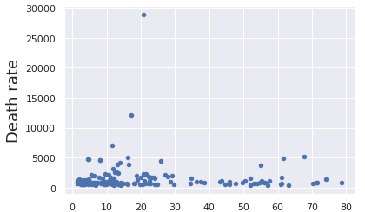
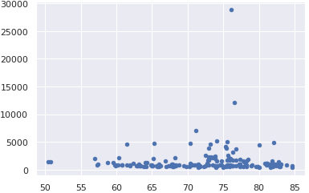
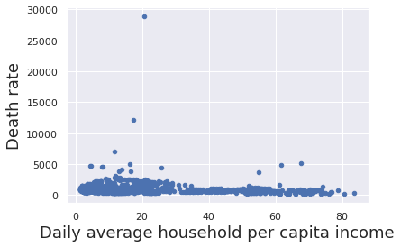
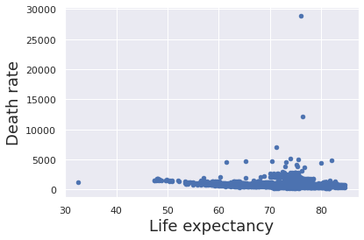
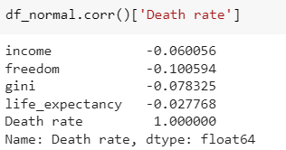
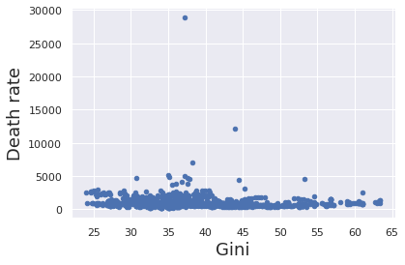
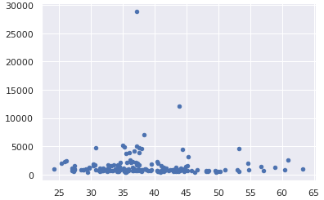
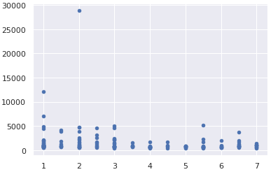
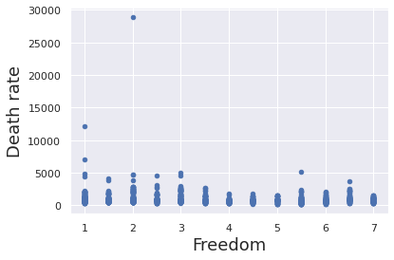
Linearity
Notes:
Pandas dataframe.corr() is used to find the pairwise correlation of all columns in the Pandas Dataframe in Python.

Slide 23
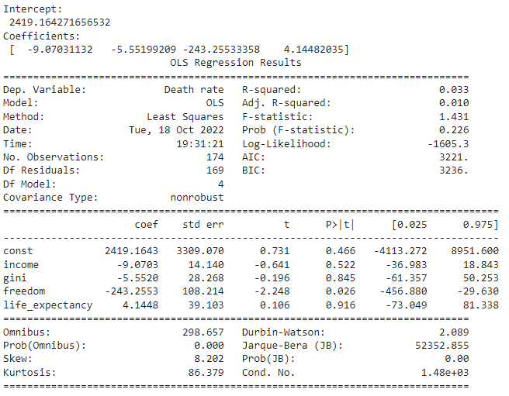
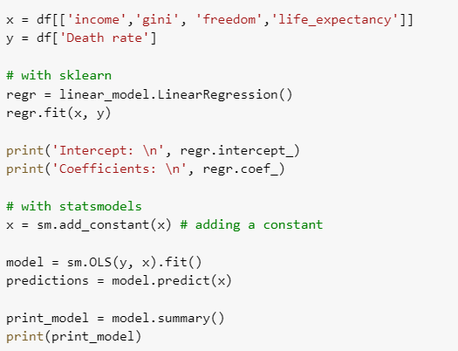
model_expr = 'Death rate ~ income + freedom + gini + life_expectancy'
Only 3.3% of the variance of the target (death rate) can be explained with this simple model
Freedom index is statistically significant to death rate
Notes:
The second assumption that one makes while fitting OLSR models is that the residual errors left over from fitting the model to the data are independent, identically distributed random variables.
We break this assumption into three parts:
The residual errors are random variables,
They are independent random variables, and
Their probability distributions are identical.

Slide 24
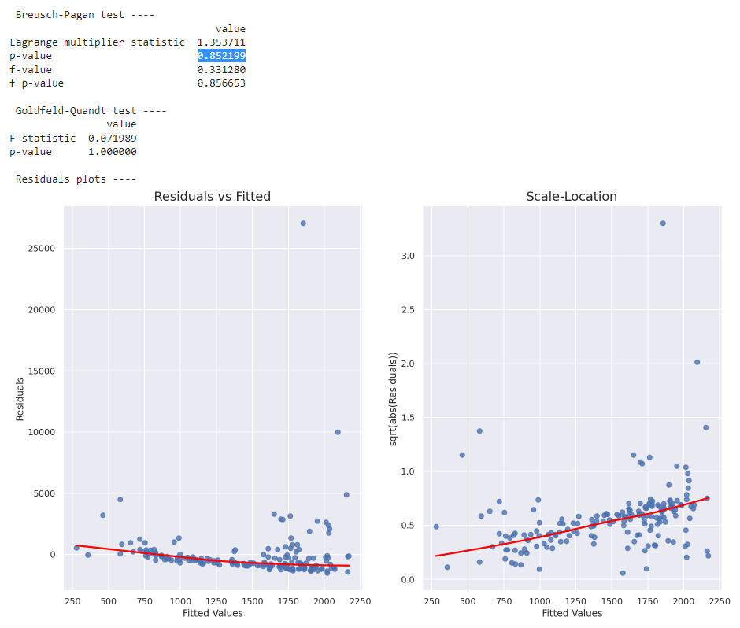
2.Homoscedasticity
There is homoscedasticity
Notes:
Multiple linear regression assumes that the amount of error in the residuals is similar at each point of the linear model. This scenario is known as homoscedasticity. When analyzing the data, the analyst should plot the standardized residuals against the predicted values to determine if the points are distributed fairly across all the values of independent variables. To test the assumption, the data can be plotted on a scatterplot or by using statistical software to produce a scatterplot that includes the entire model.
The null hypothesis is of homoskedasticity. p-value > 0.05 = we cannot reject the H0 = there is homoscedasticity
When residuals do not have constant variance (they exhibit heteroscedasticity), it is difficult to determine the true standard deviation of the forecast errors, usually resulting in confidence intervals that are too wide/narrow. For example, if the variance of the residuals is increasing over time, confidence intervals for out-of-sample predictions will be unrealistically narrow. Another effect of heteroscedasticity might also be putting too much weight to a subset of data when estimating coefficients — the subset in which the error variance was largest.
To investigate if the residuals are homoscedastic, we can look at a plot of residuals (or standardized residuals) vs. predicted (fitted) values. What should alarm us is the case when the residuals grow either as a function of predicted value or time (in case of time series).
We can also use two statistical tests: Breusch-Pagan and Goldfeld-Quandt. In both of them, the null hypothesis assumes homoscedasticity and a p-value below a certain level (like 0.05) indicates we should reject the null in favor of heteroscedasticity.
In the snippets below I plot residuals (and standardized ones) vs. fitted values and carry out the two mentioned tests. To identify homoscedasticity in the plots, the placement of the points should be random and no pattern (increase/decrease in values of residuals) should be visible — the red line in the R plots should be flat. We can see that this is not the case for our dataset.

Slide 25
Main conclusions & Discussion
Our model does not explain to an adequate extent (3.3%) the encountered variance in death rates. A possible explanation for this fact may be the high variation that exists among countries worldwide. We need additional variables (eg war/peace,epidemics…) which could better explain the variation.
Only statistically significant variable is freedom, in an unexpected way. Could the outlier influence(scatterplot) and be the cause of this?
Our data potentially portrays incongruences that might result from underreporting, specially in countries with harsher realities (scatterplots)
Notes:
Income does not appear to be stats sig to decrease death rate = are these countries governments

Slide 26

Thank you for your attention!

Slide 27
Code resources:
https://colab.research.google.com/drive/1My--5uSAXbNY7oplyx5ZYBAkIJLyM3NX?usp=sharing

Slide 28

Select a year for analysis
Our analysis was focused on 2016; Therefore the dataset was filtered for 2016

Slide 29
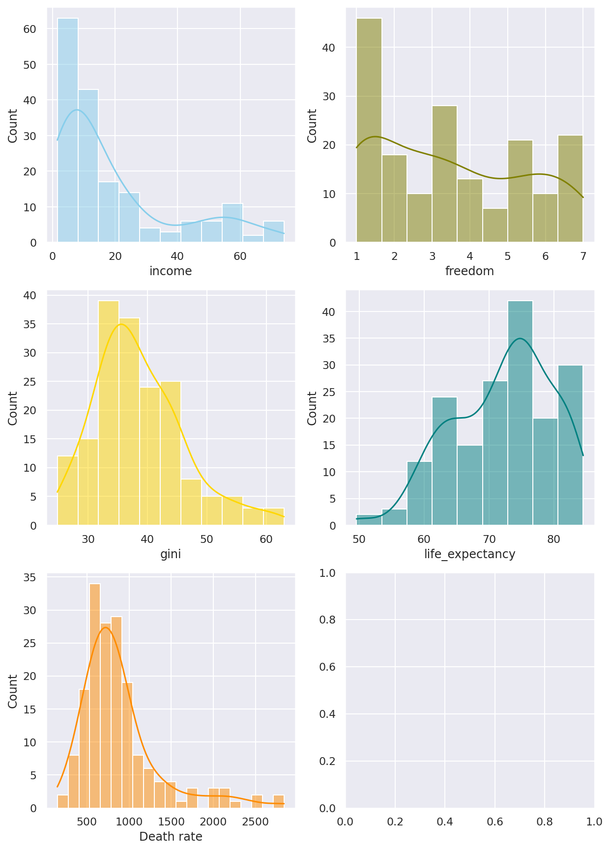
Test normality

Slide 30
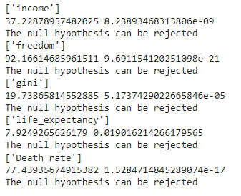
Test normality
All variables of interest were tested using the D’Agostino K-square test
H0= The sample comes from a normal distribution.
H1=The sample is not normally distributed.

Slide 31
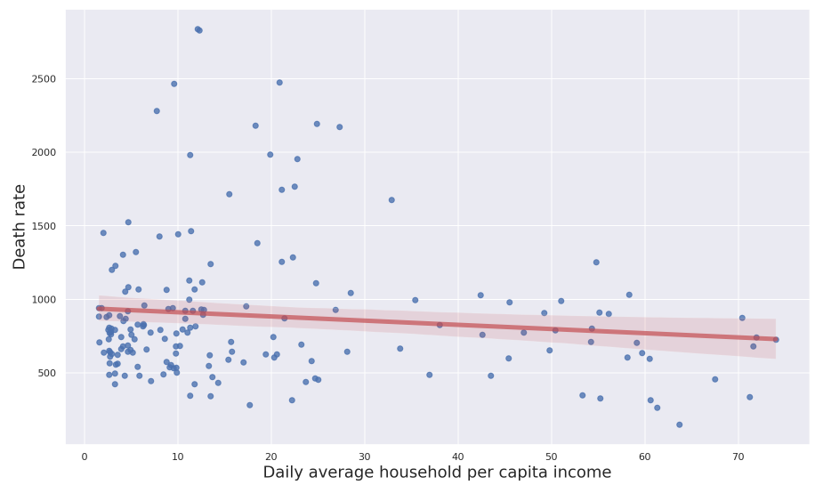
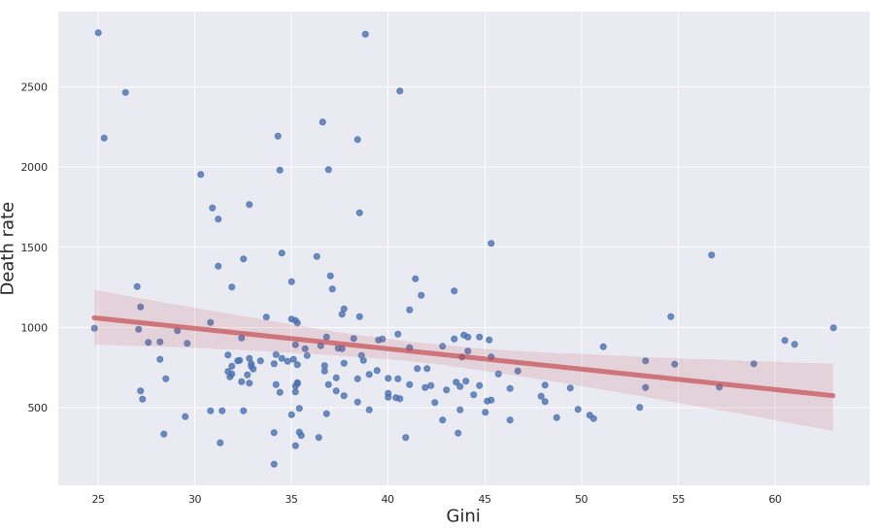
Scatterplots - pt.1

Slide 32
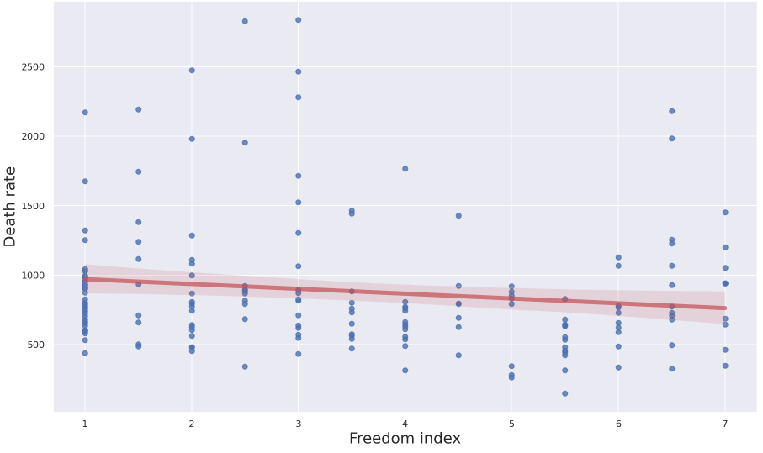
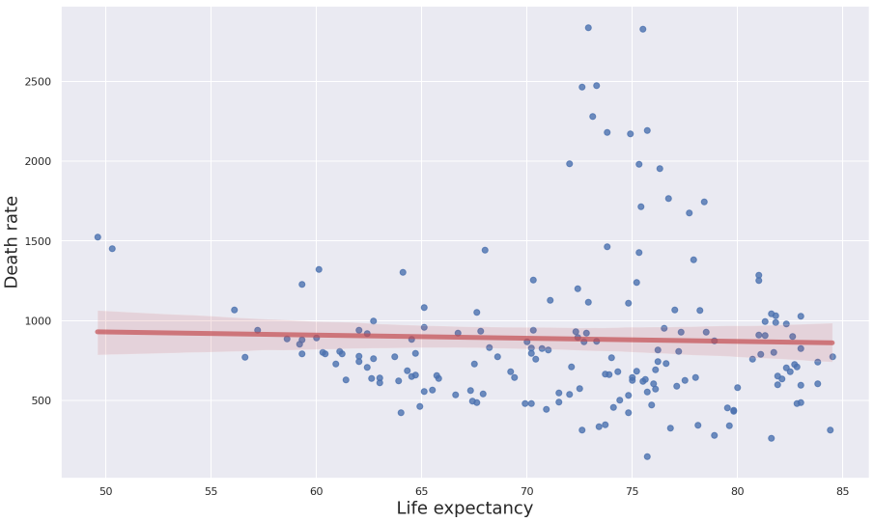
Scatterplots - pt.2

Slide 33
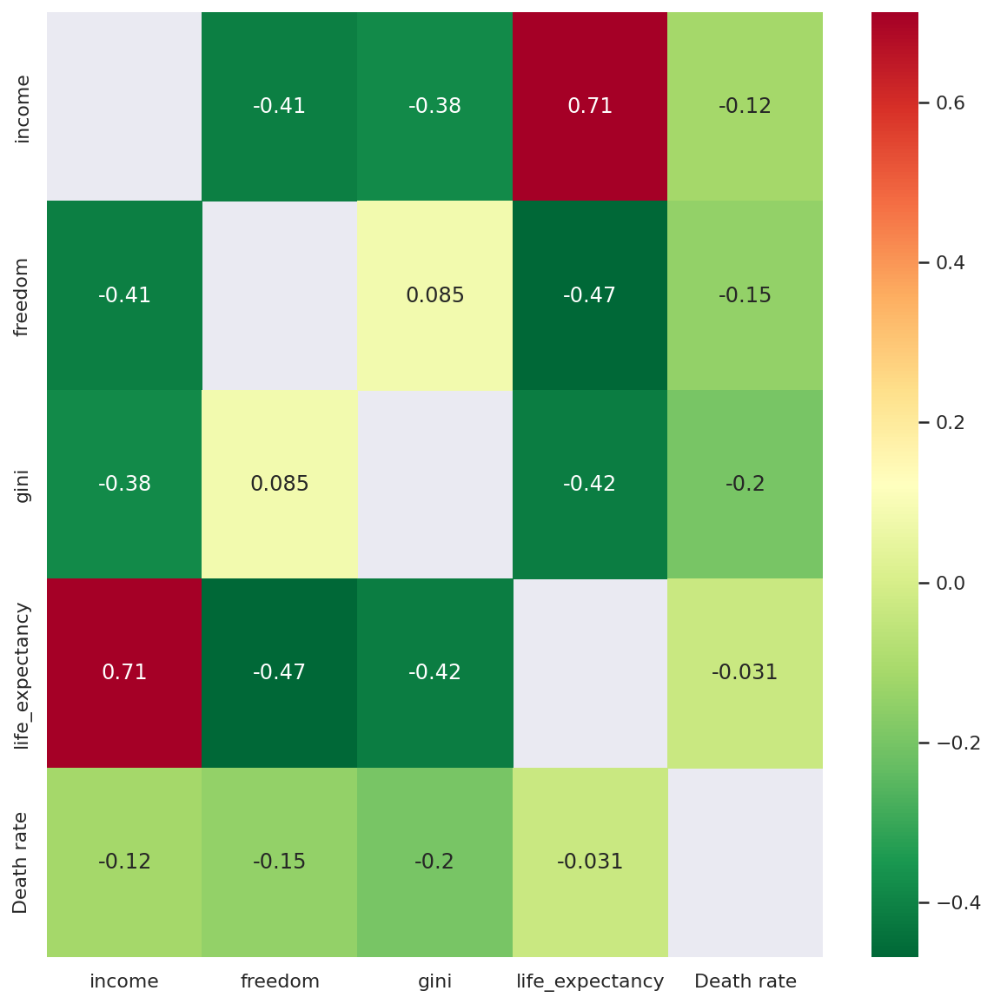
Correlogram
As the average daily household per capita income (income) increases, life expectancy increases
Notes:
The correlogram represents the correlations for all pairs of variables. Positive correlations are displayed in red and negative correlations in green. The intensity of the color is proportional to the correlation coefficient so the stronger the correlation (i.e., the closer to -1 or 1), the darker the boxes. The color legend on the right hand side of the correlogram shows the correlation coefficients and the corresponding colors.
As a reminder, a negative correlation (green) implies that the two variables under consideration vary in opposite directions, that is, if one variable increases the other decreases and vice versa. A positive correlation (red) implies that the two variables under consideration vary in the same direction, that is, if one variable increases the other increases and if one variable decreases the other decreases as well. Furthermore, the stronger the correlation, the stronger the association between the two variables.

Slide 34
Model hypothesis
Multiple Linear regression
H0: Death rate is not affected by the country’s average daily household per capita income, life expectancy, gini coefficient and freedom index
H1: Death rate is affected by the country’s average daily household per capita income, life expectancy, gini coefficient and freedom index
Notes:
Multiple linear regression analysis makes several key assumptions:
There must be a linear relationship between the outcome variable and the independent variables. Scatterplots can show whether there is a linear or curvilinear relationship.
Multivariate Normality–Multiple regression assumes that the residuals are normally distributed.
No Multicollinearity—Multiple regression assumes that the independent variables are not highly correlated with each other. This assumption is tested using Variance Inflation Factor (VIF) values.

Slide 35
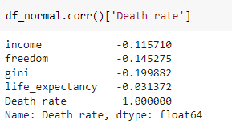
Linearity
Notes:
Fitting a linear model to data with non-linear patterns results in serious prediction errors, especially out-of-sample (data not used for training the model).
Potential solutions:
non-linear transformations to dependent/independent variables
adding extra features which are a transformation of the already used ones (for example squared version)
adding features that were not considered before

Slide 36
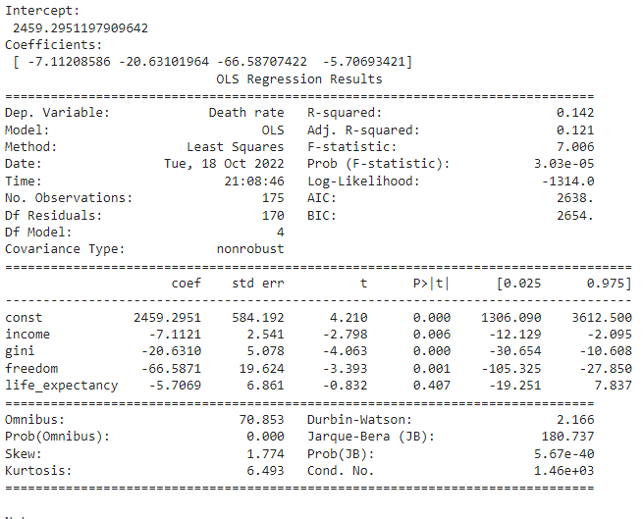
model_expr = 'Death rate ~ income + freedom + gini + life_expectancy'
Only 14.2% of the variance of the target (death rate) can be explained with this simple model
Household income, Gini coefficient and Freedom index are statistically significant to death rate
Notes:
The second assumption that one makes while fitting OLSR models is that the residual errors left over from fitting the model to the data are independent, identically distributed random variables.
We break this assumption into three parts:
The residual errors are random variables,
They are independent random variables, and
Their probability distributions are identical.

Slide 37
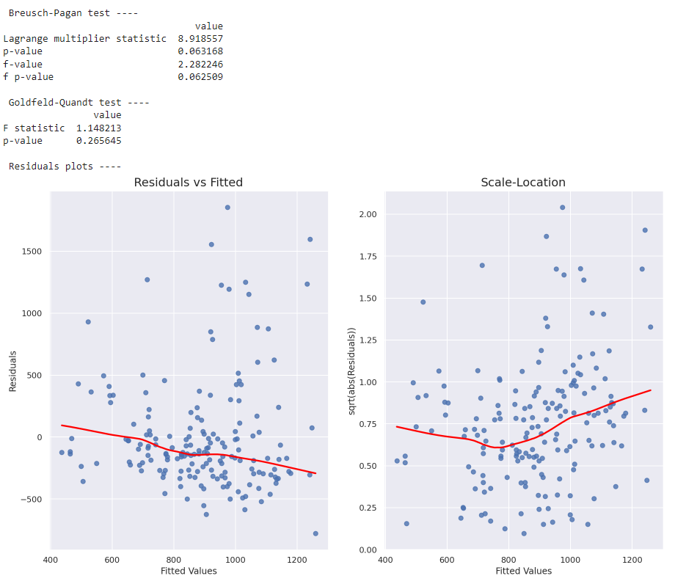
2.Homoscedasticity
There is homoscedasticity
Notes:
Potential solutions:
log transformation of the dependent variable
in case of time series, deflating a series if it concerns monetary value
using ARCH (auto-regressive conditional heteroscedasticity) models to model the error variance. An example might be stock market, where data can exhibit periods of increased or decreased volatility over time (volatility clustering, see this article for more information)
The null hypothesis is of homoskedasticity. p-value > 0.05 = we cannot reject the H0 = there is homoscedasticity
When residuals do not have constant variance (they exhibit heteroscedasticity), it is difficult to determine the true standard deviation of the forecast errors, usually resulting in confidence intervals that are too wide/narrow. For example, if the variance of the residuals is increasing over time, confidence intervals for out-of-sample predictions will be unrealistically narrow. Another effect of heteroscedasticity might also be putting too much weight to a subset of data when estimating coefficients — the subset in which the error variance was largest.
To investigate if the residuals are homoscedastic, we can look at a plot of residuals (or standardized residuals) vs. predicted (fitted) values. What should alarm us is the case when the residuals grow either as a function of predicted value or time (in case of time series).
We can also use two statistical tests: Breusch-Pagan and Goldfeld-Quandt. In both of them, the null hypothesis assumes homoscedasticity and a p-value below a certain level (like 0.05) indicates we should reject the null in favor of heteroscedasticity.
In the snippets below I plot residuals (and standardized ones) vs. fitted values and carry out the two mentioned tests. To identify homoscedasticity in the plots, the placement of the points should be random and no pattern (increase/decrease in values of residuals) should be visible — the red line in the R plots should be flat. We can see that this is not the case for our dataset.

Slide 38
Main conclusions & Discussion
Our model does not explain to an adequate extent (3.3%) the encountered variance in death rates. A possible explanation for this fact may be the high variation that exists among countries worldwide. We need additional variables (eg war/peace,epidemics…) which could better explain the variation.
Freedom is statistically significant; Higher freedom indexes (meaning less freedom) = smaller death rates. Expeculation : Does government repression increase death rate (eg actual Iranian situation; North Korea)?
Gini is statistically significant and higher gini coefficient = smaller death rates.
Our data potentially portrays incongruences that might result from underreporting, specially in countries with harsher realities (scatterplots)
Notes:
Income does not appear to be stats sig to decrease death rate = are these countries governments

